Slide 1
THE FIRST 3000 RESCUES
Notes:
Done

Slide 2
THE FIRST 3000 RESCUES
Notes:
Done

Slide 3
THE FIRST 3000 RESCUES
Notes:
Done

Slide 4
THE FIRST 3000 RESCUES
Notes:
Done

Slide 5
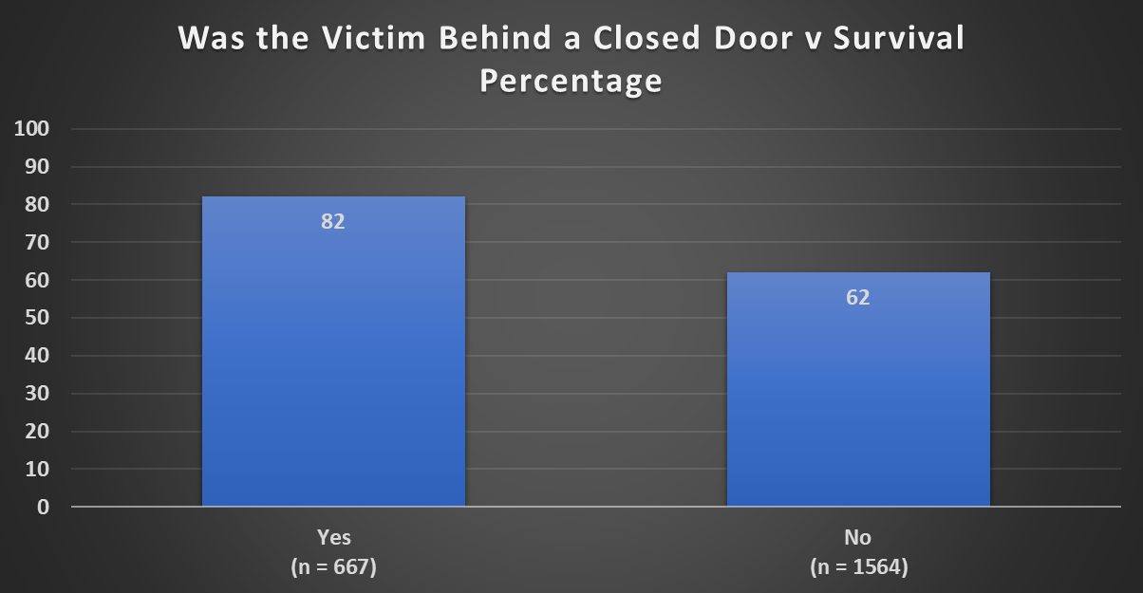
THE FIRST 3000 RESCUES
Notes:
Done

Slide 6
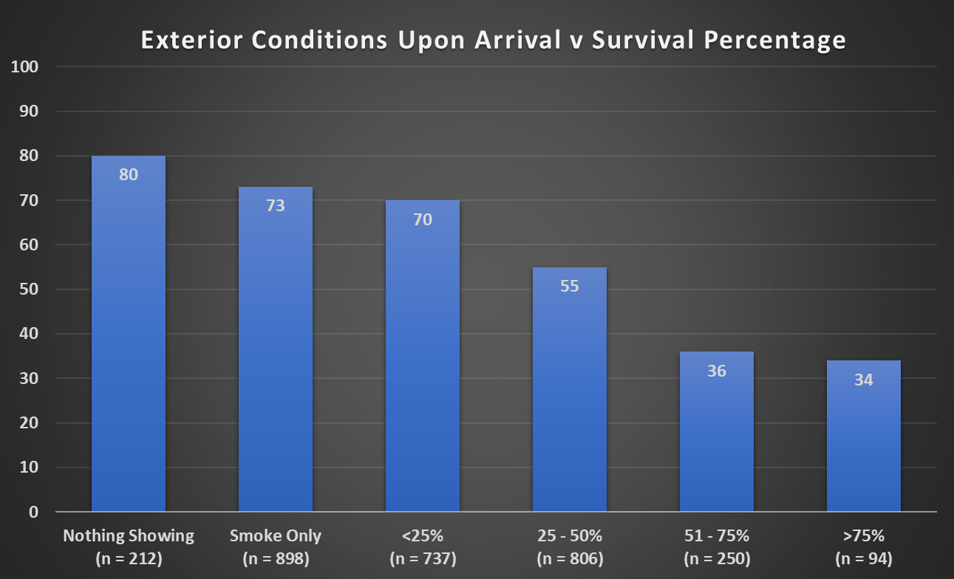
THE FIRST 3000 RESCUES
Notes:
1.1

Slide 7
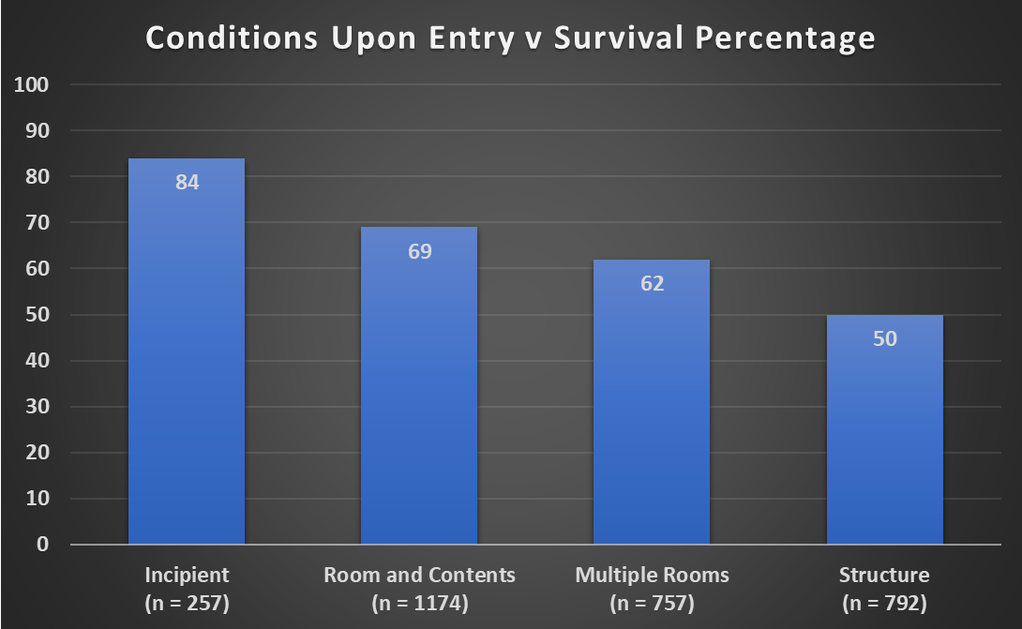
THE FIRST 3000 RESCUES
Notes:
Done

Slide 8
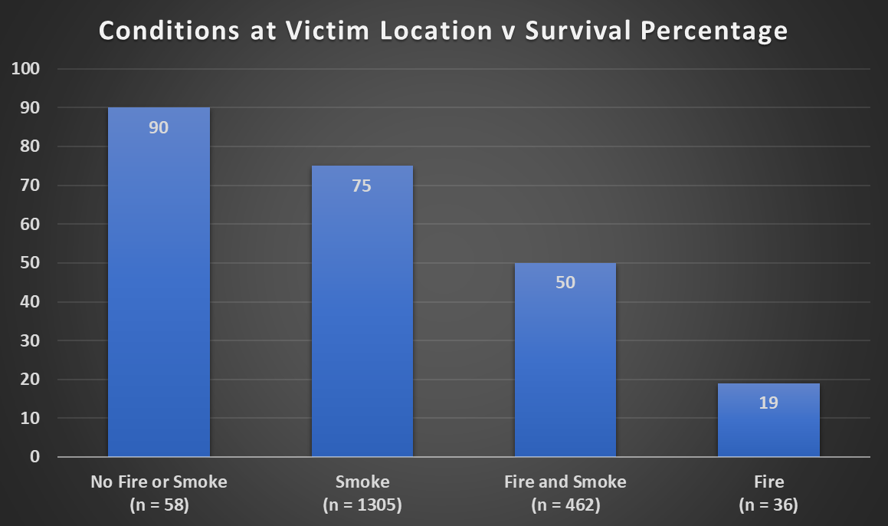
THE FIRST 3000 RESCUES
Notes:
Done

Slide 9
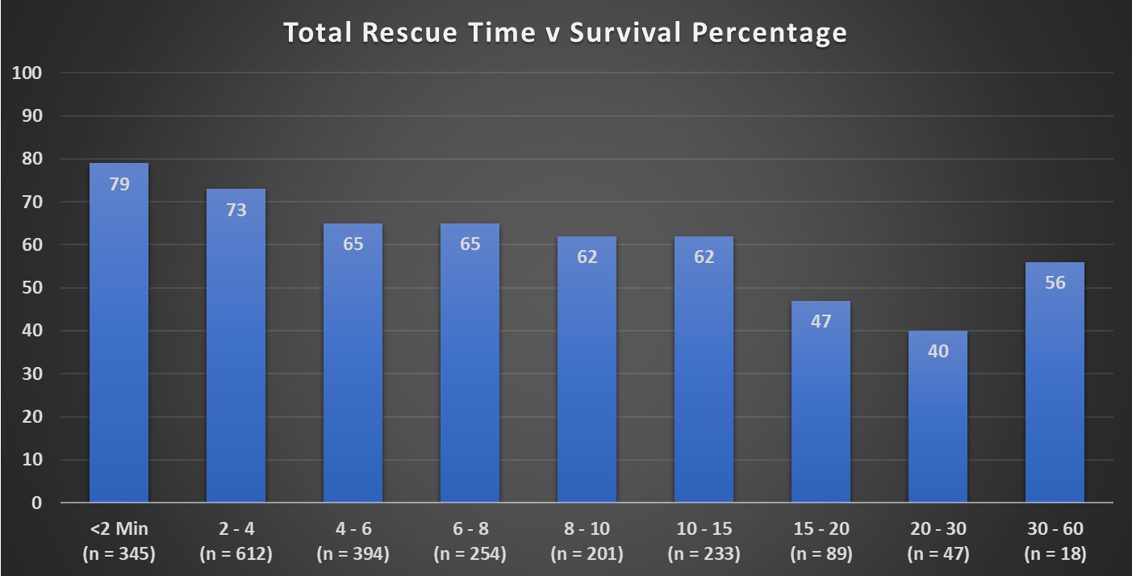
THE FIRST 3000 RESCUES
Notes:
Done

Slide 10
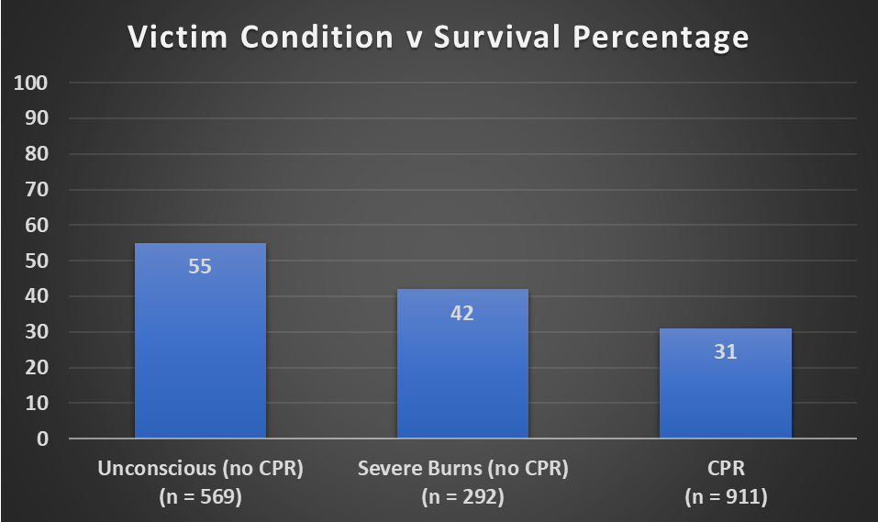
THE FIRST 3000 RESCUES
Notes:
Done

Slide 11
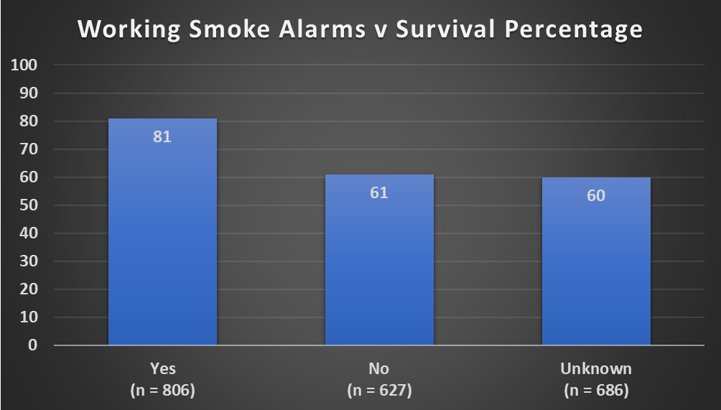
THE FIRST 3000 RESCUES
Notes:
Done

Slide 12
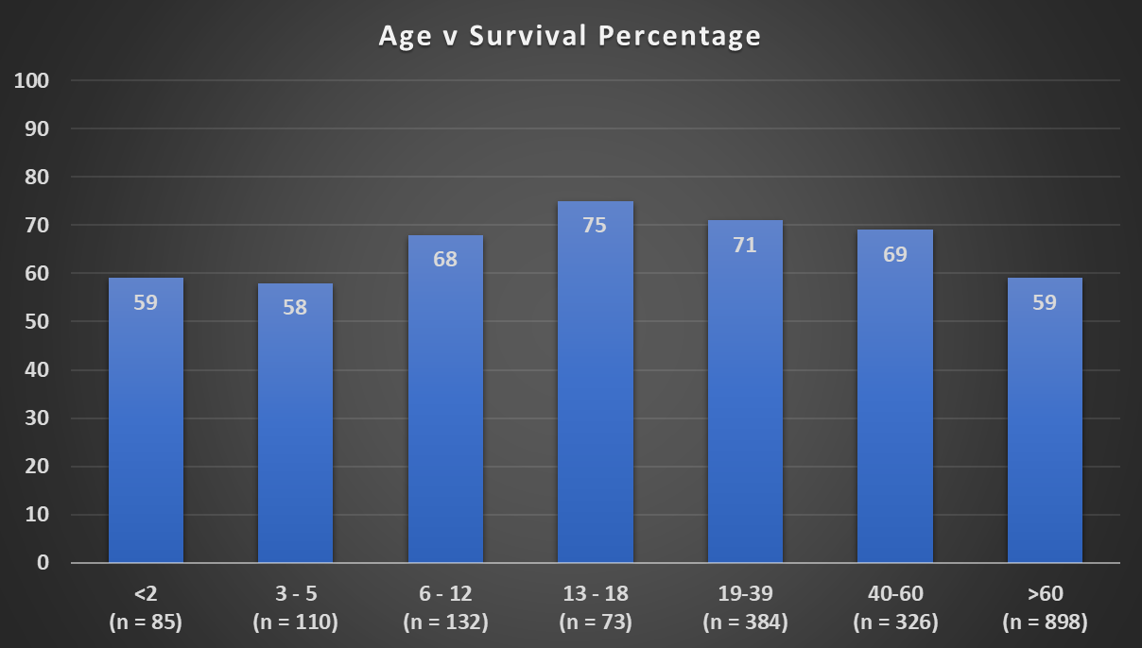
THE FIRST 3000 RESCUES
Notes:
Done

Slide 13
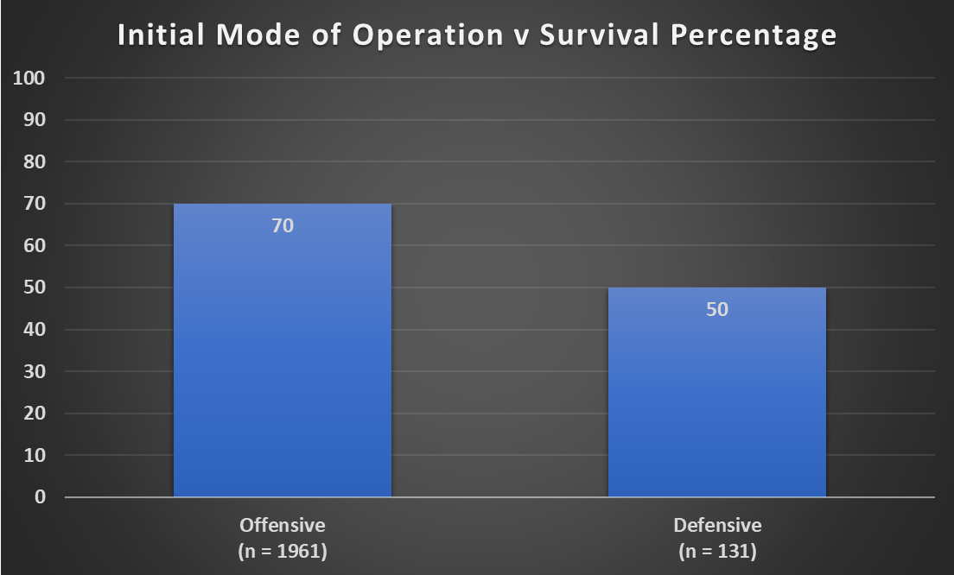
THE FIRST 3000 RESCUES
Notes:
Done

Slide 14
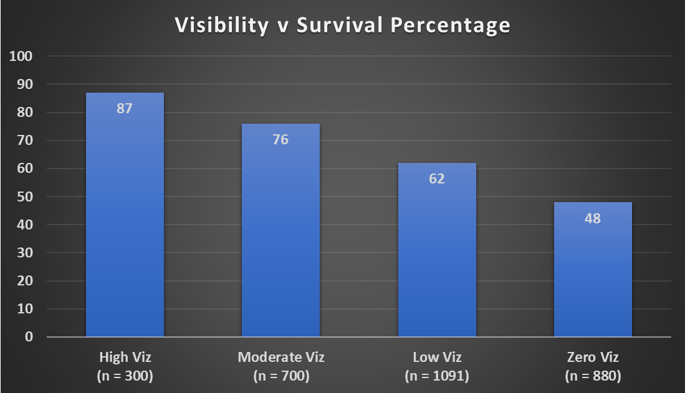
THE FIRST 3000 RESCUES
Notes:
Done

Slide 15
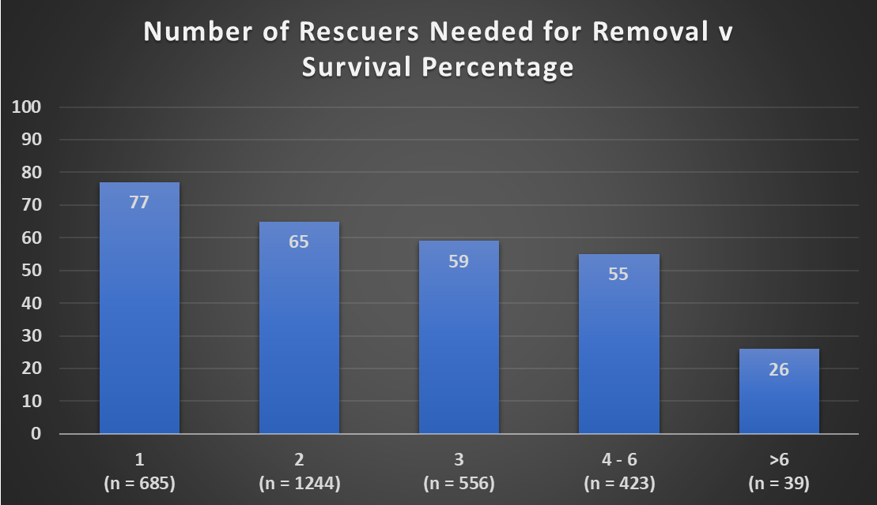
THE FIRST 3000 RESCUES
Notes:
Done

Slide 16
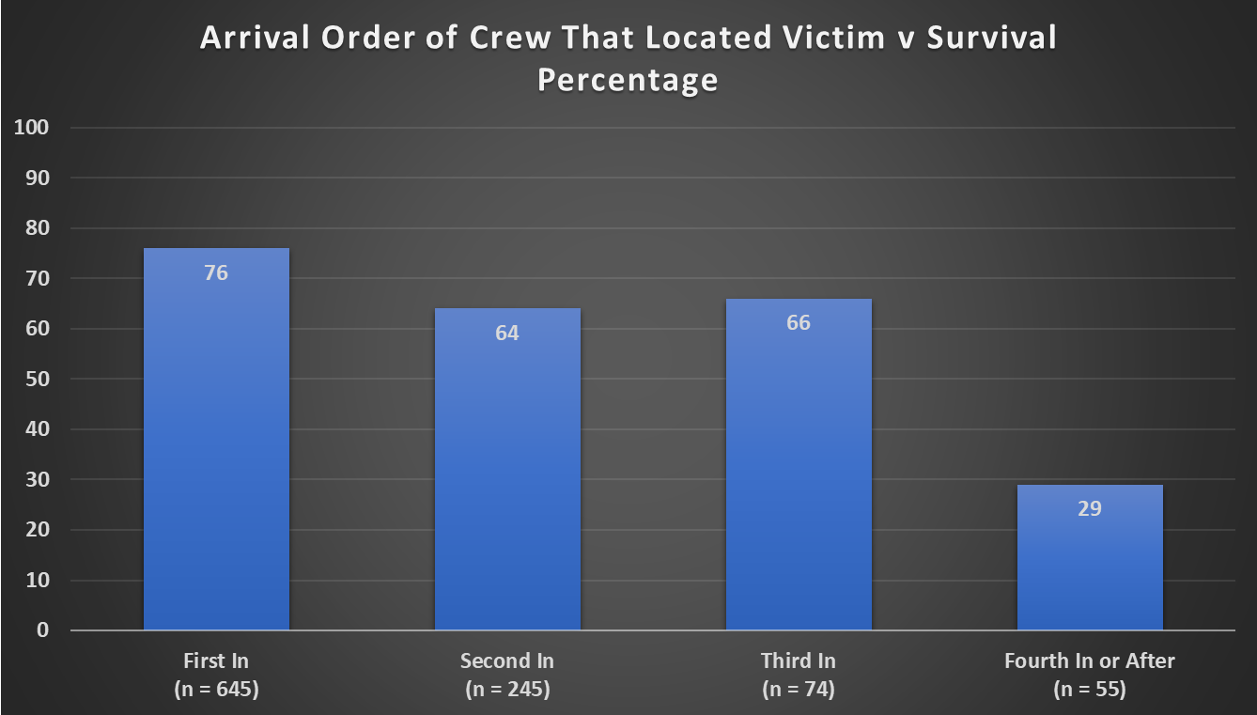
THE FIRST 3000 RESCUES
Notes:
Done

Slide 17
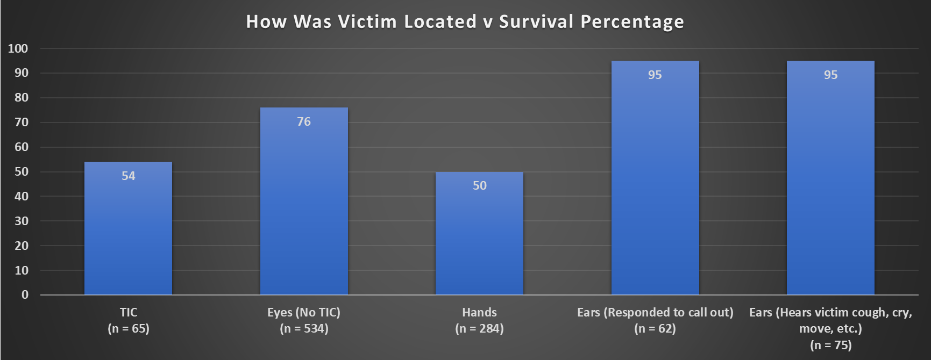
THE FIRST 3000 RESCUES
Notes:
Done

Slide 18
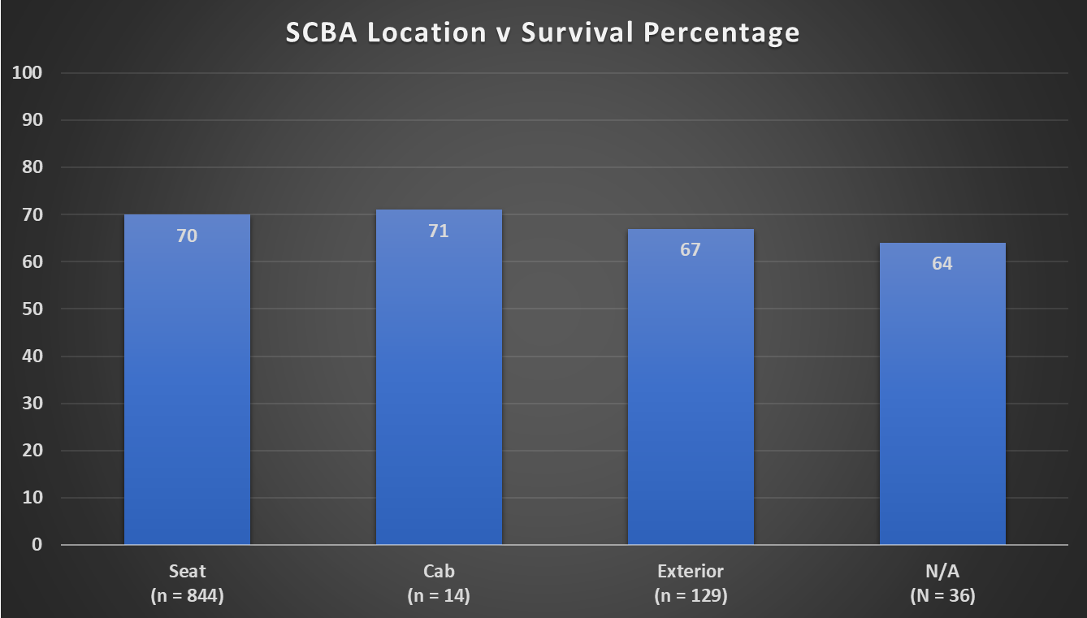
THE FIRST 3000 RESCUES
Notes:
Done

Slide 19
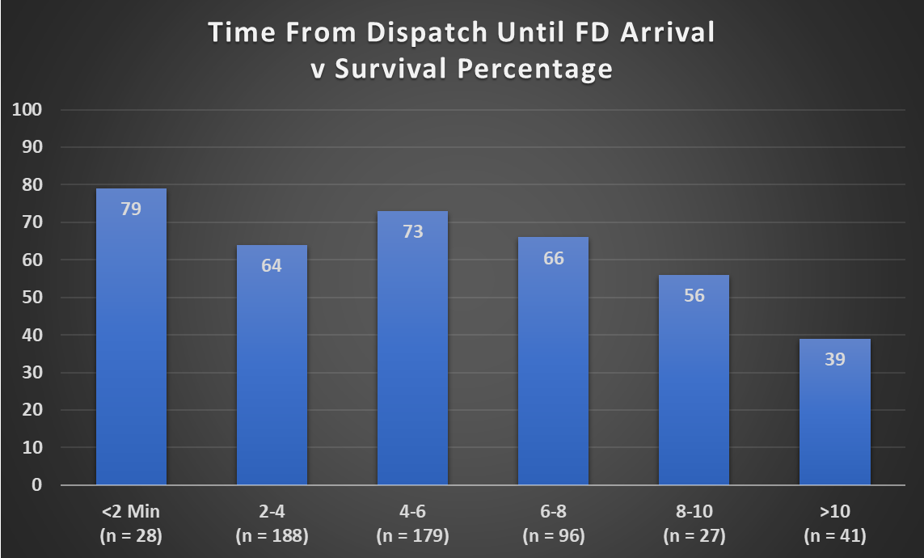
Notes:
Done

Slide 20
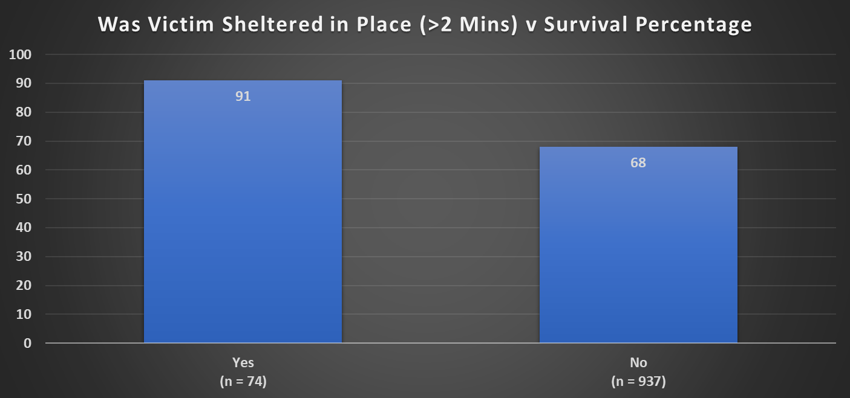
THE FIRST 3000 RESCUES
Notes:
Done

Slide 21
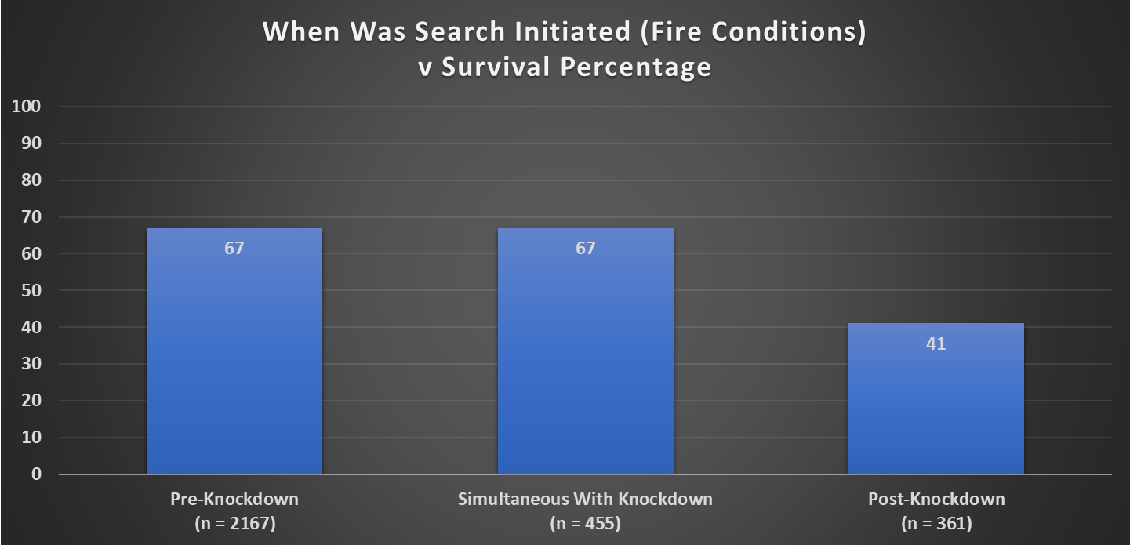
THE FIRST 3000 RESCUES
Notes:
Done

Slide 22
THE FIRST 3000 RESCUES
Notes:
Done

Slide 23
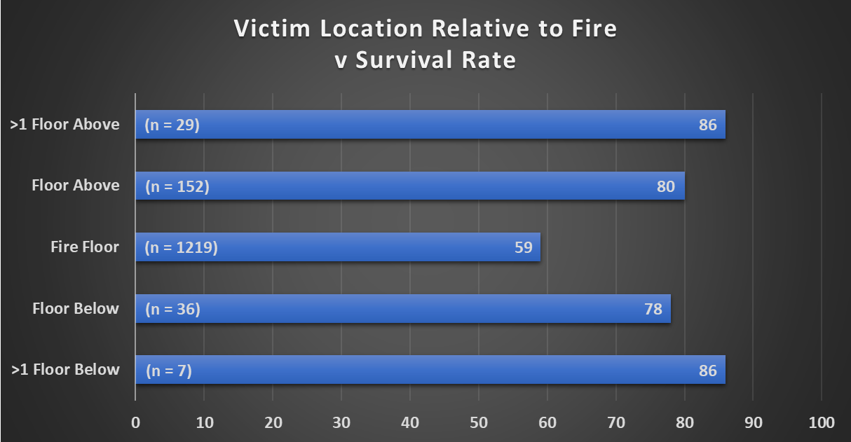
THE FIRST 3000 RESCUES
Notes:
Done

Slide 24
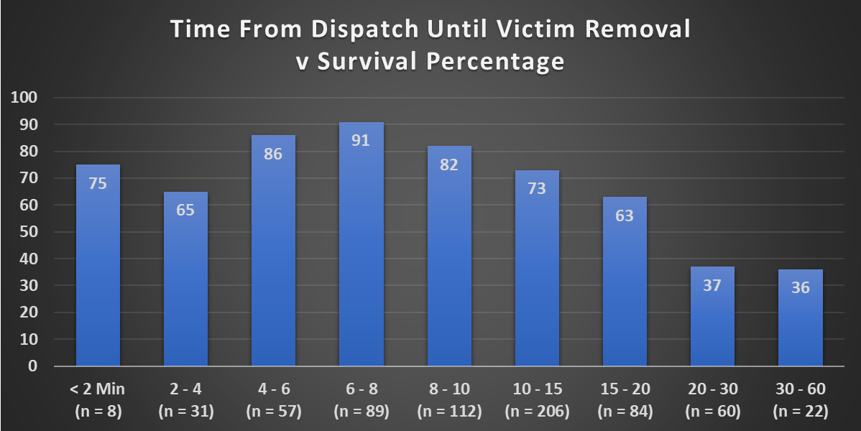
THE FIRST 3000 RESCUES
Notes:
Done

Slide 25
THE FIRST 3000 RESCUES
Notes:
Done

Slide 26
THE FIRST 3000 RESCUES
Notes:
Done

Slide 27
THE FIRST 3000 RESCUES
Notes:
Done

Slide 28
THE FIRST 3000 RESCUES
Notes:
Done

Slide 29
THE FIRST 3000 RESCUES
Notes:
Done

Slide 30
THE FIRST 3000 RESCUES
Notes:
Done

Slide 31
THE FIRST 3000 RESCUES
Notes:
Done

Slide 32
THE FIRST 3000 RESCUES
Notes:
Done

Slide 33
THE FIRST 3000 RESCUES
Notes:
Done

Slide 34
THE FIRST 3000 RESCUES
Notes:
Done

Slide 35
THE FIRST 3000 RESCUES
Notes:
Done

Slide 36
THE FIRST 3000 RESCUES
Notes:
Done

Slide 37
THE FIRST 3000 RESCUES
Notes:
Done

Slide 38
THE FIRST 3000 RESCUES
Notes:
Done

Slide 39
THE FIRST 3000 RESCUES
Notes:
Done

Slide 40
THE FIRST 3000 RESCUES
Notes:
Done

Slide 41
THE FIRST 3000 RESCUES
Notes:
Done

Slide 42
THE FIRST 3000 RESCUES
Notes:
Done

Slide 43
THE FIRST 3000 RESCUES
Notes:
Done

Slide 44
THE FIRST 3000 RESCUES
Notes:
Done

Slide 45
THE FIRST 3000 RESCUES
Notes:
Done

Slide 46
THE FIRST 3000 RESCUES
Notes:
Done

Slide 47
THE FIRST 3000 RESCUES
Notes:
Done

Slide 48
THE FIRST 3000 RESCUES
Notes:
Done

